Slide 1


Time Consumption Analysis

Slide 2
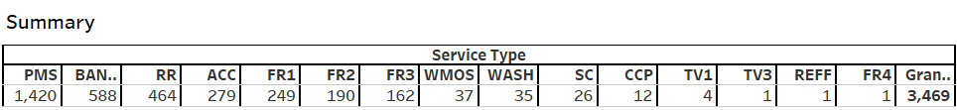
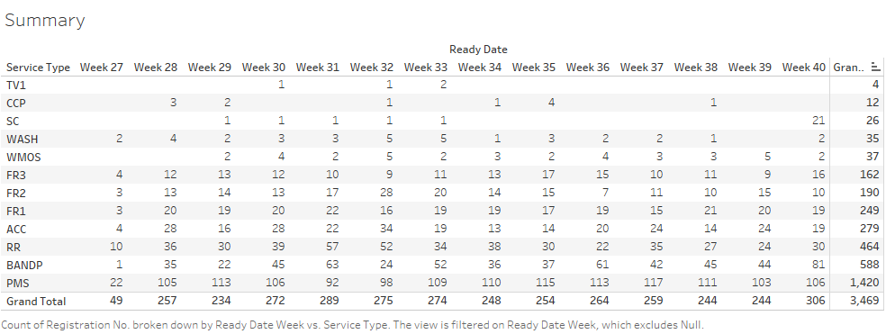
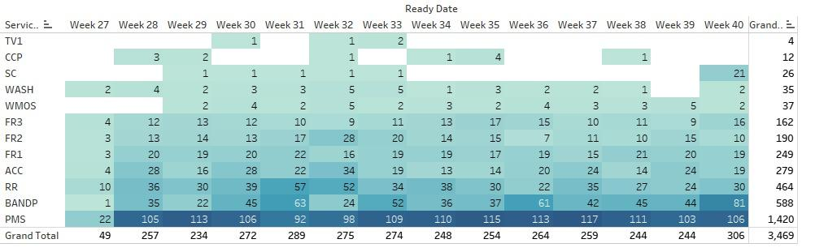

Slide 3
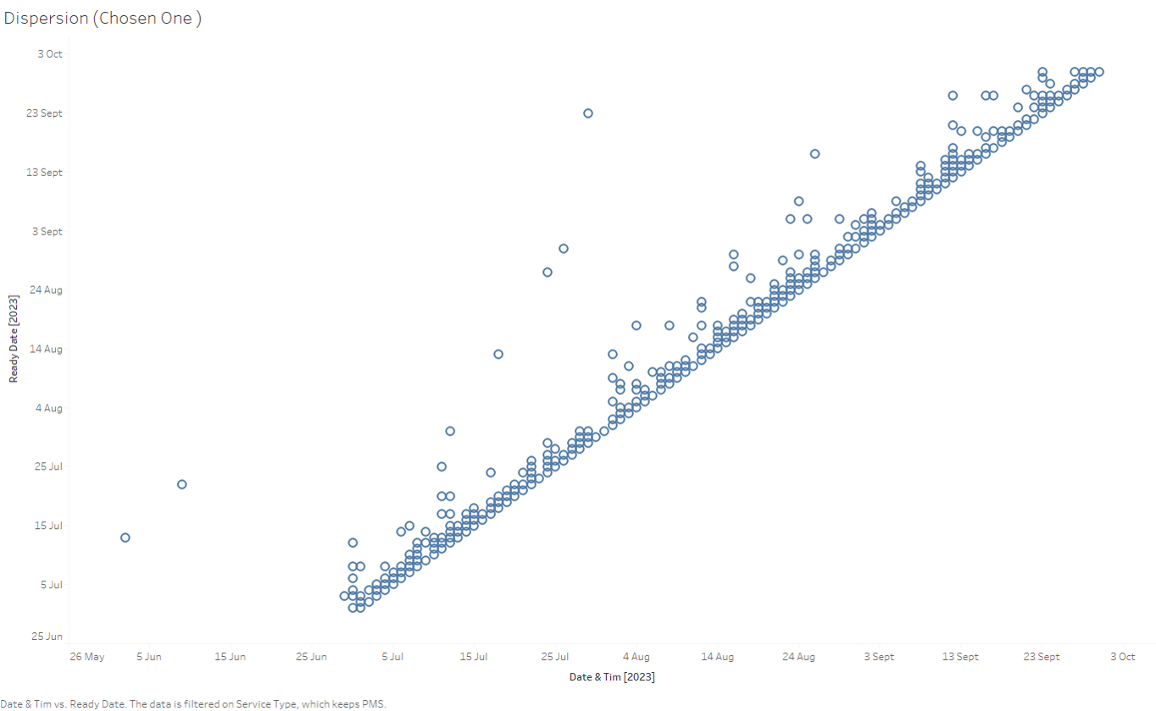
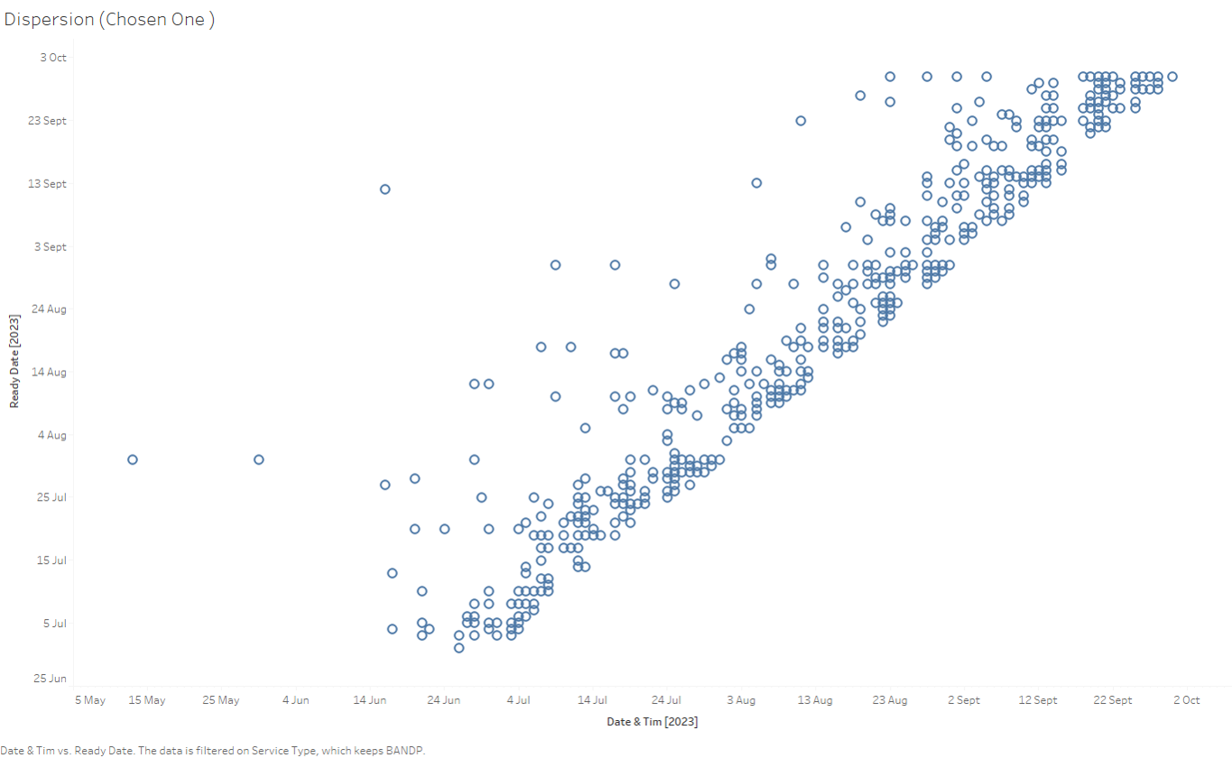
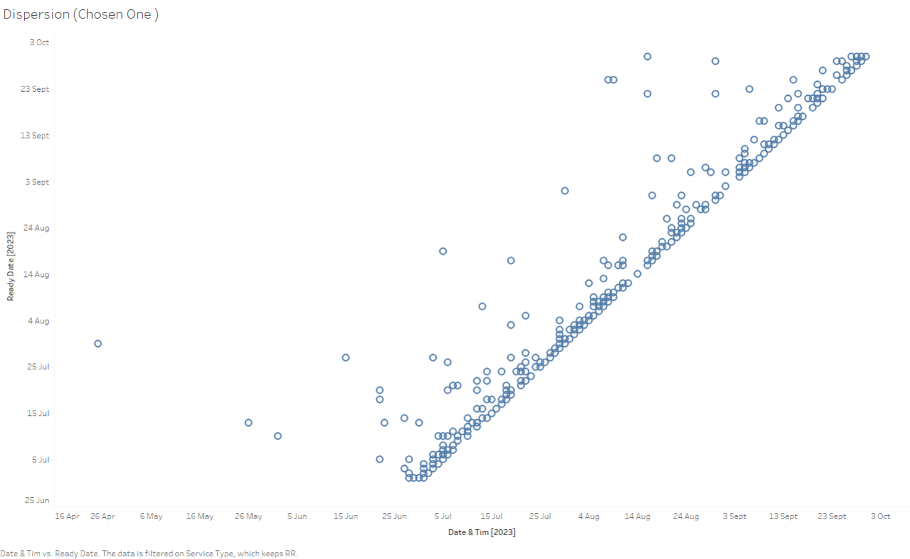
dispersion in completing BANDP service
PMS
RR
The scatter plot shows a relatively tight distribution of PMS service times. On average, PMS service accounted for 19.67% of the total service time for the car during its service life.

Slide 4

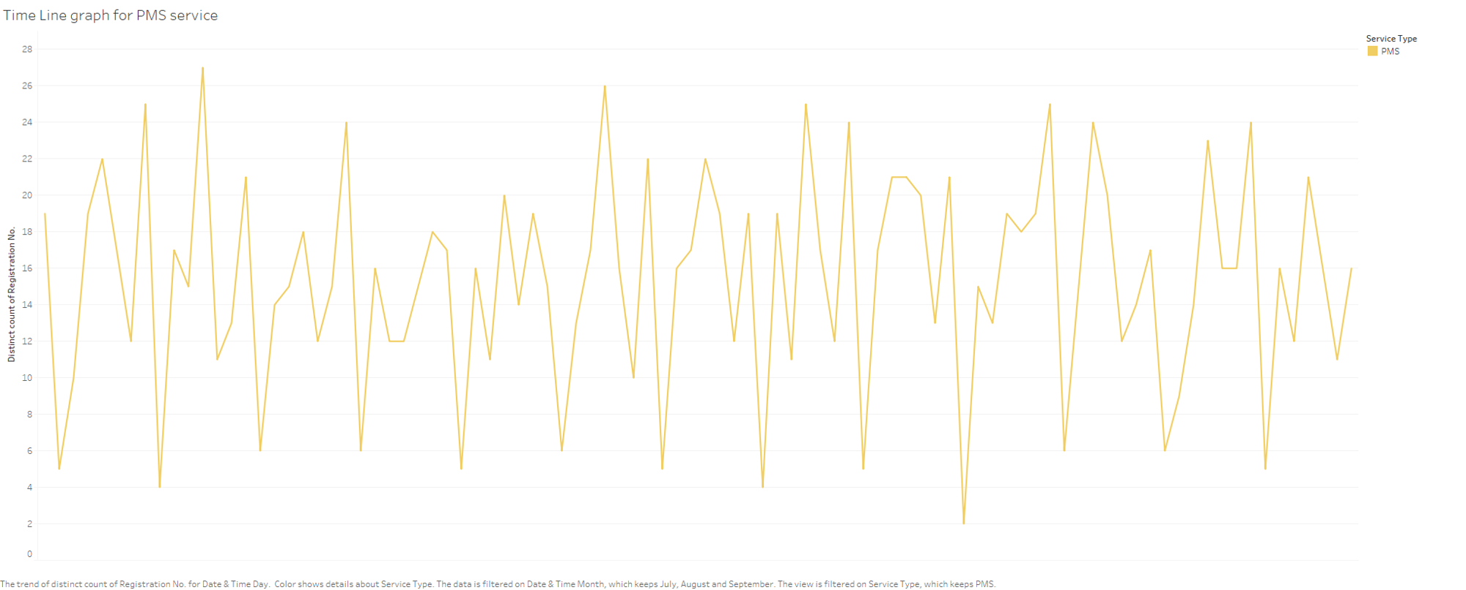
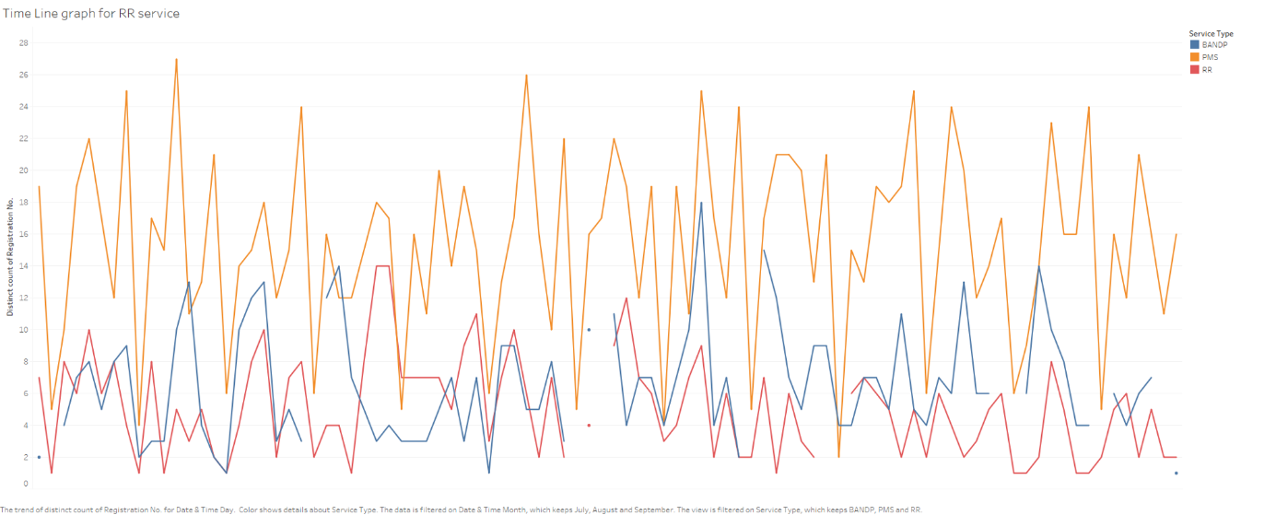
This graph represents the data wise analysis of car services requests based on their service type. Through the graph we can see that there is pattern when we consider the PMS services, which is Periodic maintenance service. It sipkes on Wednesdays and Saturdays, while have minimum requests on Sundays

